Slide 1
Design and Development of Digital Agricultural Crop Prediction System
Bachelor of Technology in Computer Science & Engineering (2025-2026)
Teki Sai Raj (22NR1A05D8)
BH.V.V.S Akhil (23NR5A0502)
Vanjarapu Arun Kumar (22NR1A05E0)
Tatta Siddhu (22NR1A05D6)
Under the Esteemed Guidance of: Ms. S. Harshini (Asst. Prof, CSE)
Baba Institute of Technology and Sciences, Visakhapatnam

Slide 2
Contents
1. Introduction
2. SRS Overview
3. UML Diagrams
4. Implementation
5. Future Enhancements

Slide 3
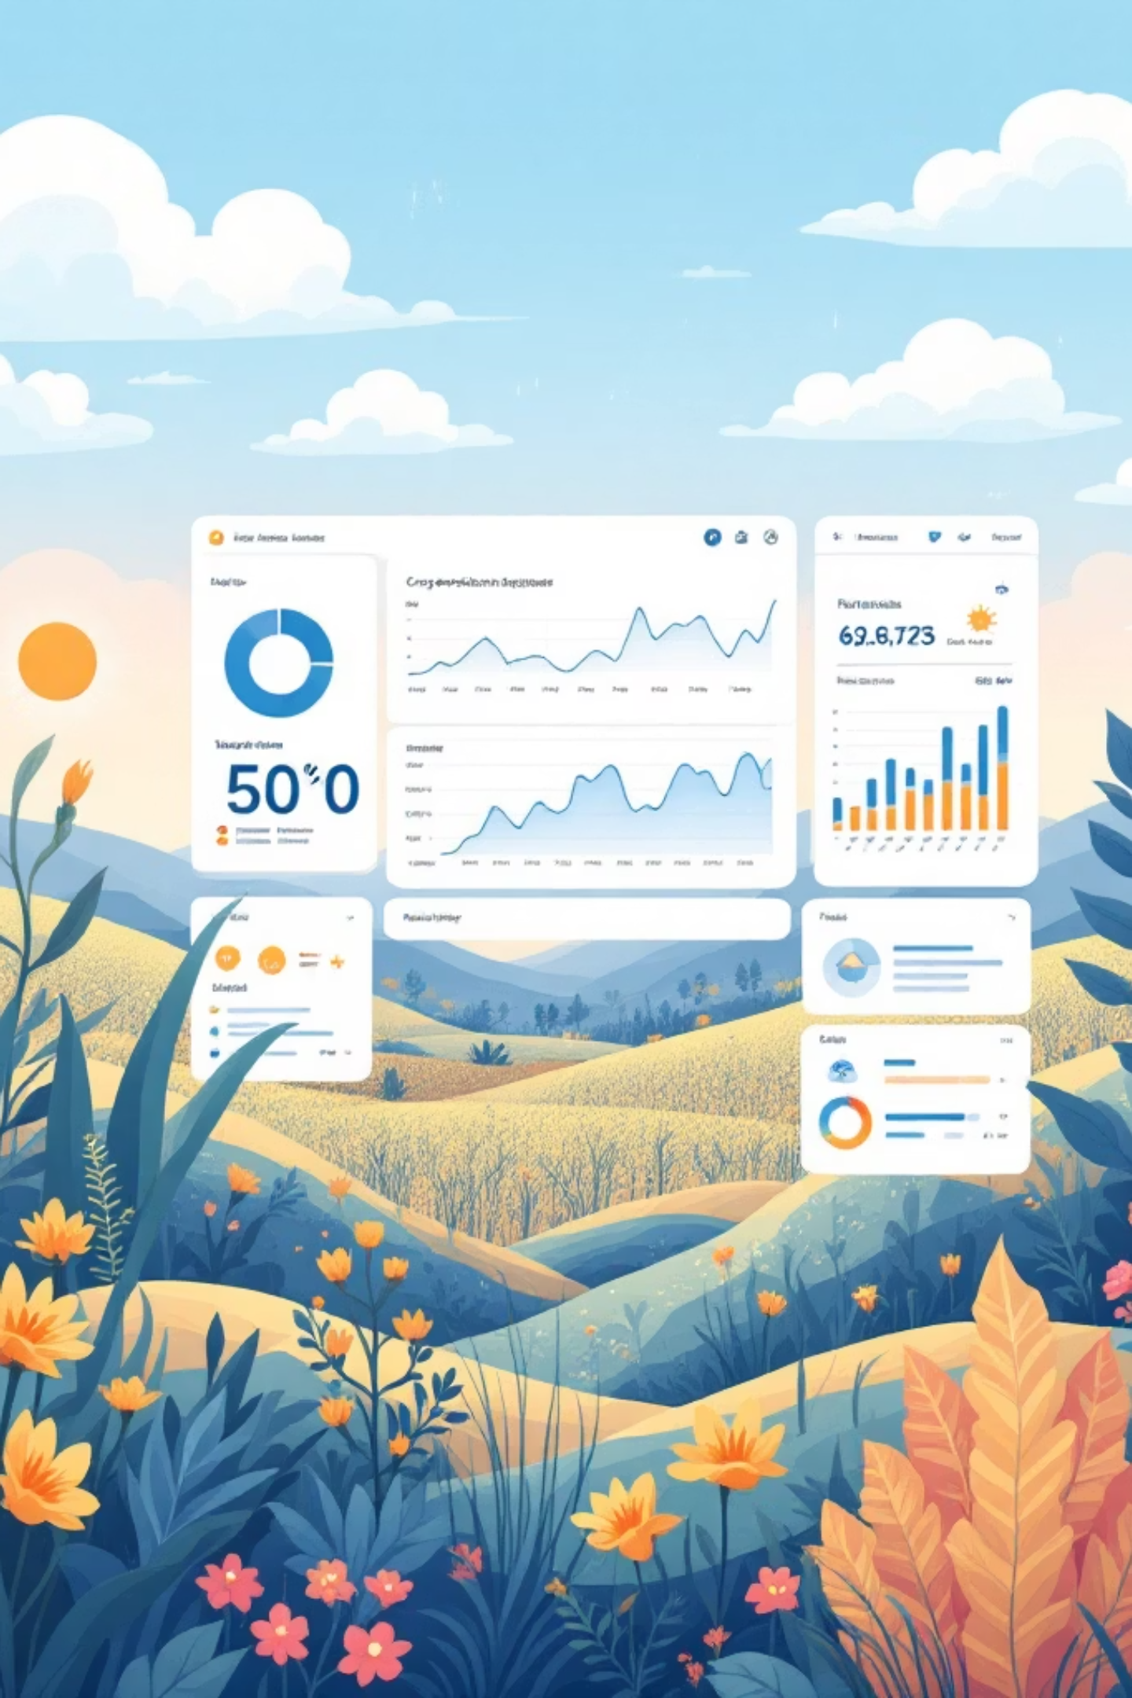
Abstract
Agriculture faces challenges such as unpredictable weather, low productivity and dependence on traditional practices. This project proposes an intelligent, location-aware system that uses Machine Learning to transform farming into a data-driven process. Key features include crop recommendation, yield prediction, resource optimization, and disease detection. The goal is to improve productivity, reduce costs, and promote sustainable farming.

Slide 4
CHAPTER 1
INTRODUCTION

Slide 5
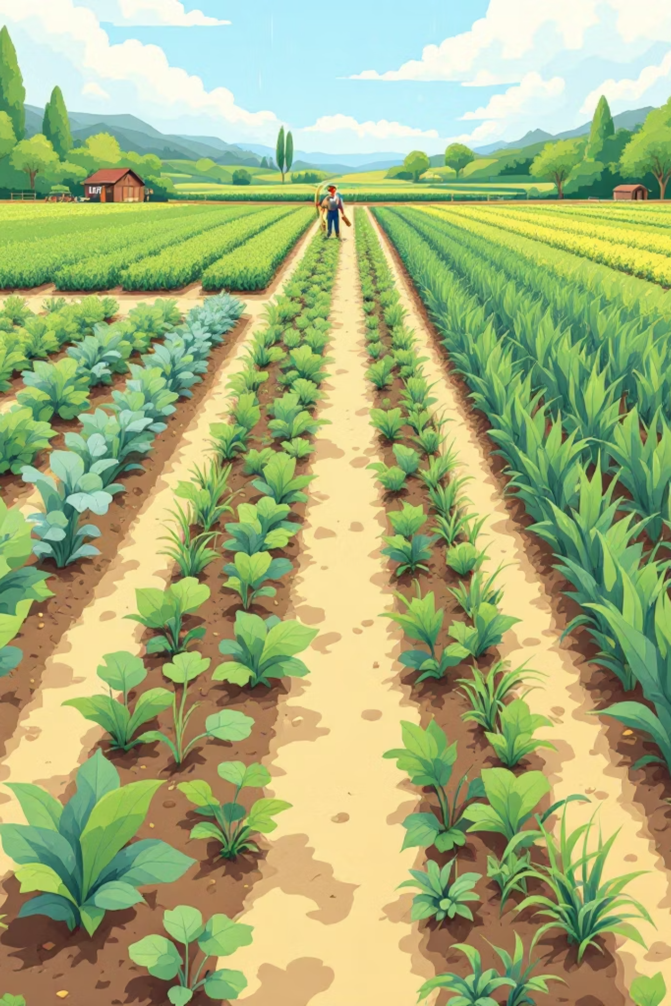
Introduction
Agriculture serves as a critical sector that supports the livelihoods of a massive population globally. The industry remains highly vulnerable due to its heavy dependence on unpredictable environmental factors such as climate change, soil degradation, and water scarcity.
The Decision Gap: Traditional farming practices rely heavily on experience and assumptions rather than scientific, real-time data, creating a gap between decision-making and actual field conditions.
Need for Modernization: There is an urgent need to transform conventional farming into a modern, data-driven process to overcome limitations like poor yield and financial losses.
System Objective: The proposed system leverages machine learning and data analytics to provide actionable insights tailored to specific geographic locations.

Slide 6
Problem Statement
Lack of Location-Specific Guidance
Inefficient Resource Management
Crop selection is often based on past trends rather than soil suitability.
Excessive or insufficient use of water and fertilizers.
Weather Vulnerability
Late Disease Detection
Lack of systems to adjust farming based on real-time weather changes.
Manual inspection is slow and often inaccurate.

Slide 7
Feasibility Study
Technical
Operational
Economic
Uses available hardware (smartphones/kits) and mature software (Python, React, TensorFlow).
Simple UI which ensures user acceptance.
Cost-benefit analysis shows 15-20% Increase in productivity and 20-30% reduction in costs.

Slide 8

Existing System
The current agricultural system is largely based on traditional farming methods passed down through generations, relying on intuition rather than data.
Manual Soil Testing
The process is slow, often taking weeks to deliver results from labs or agricultural offices.
Irrigation Management
Practices are based on visual inspection or fixed schedules, leading to water loss or nutrient leaching.
Generalized Advice
Existing advice is often given at a regional level and fails to consider the specific conditions of an individual farm.

Slide 9






Proposed System
The proposed system is an integrated, location-aware platform designed to provide tailored recommendations based on specific farm conditions.
Integrated Platform
Recommendation
Yield Prediction
Combines soil data, weather updates, and ML models into one app.
Analyzes soil parameters and climatic factors to suggest the most suitable crops for maximum productivity.
Provides expected yield estimates before cultivation begins, supporting better financial and market planning.
Resource Optimization
Disease Detection
Weather Information
Calculates precise water requirements and dynamically adjusts irrigation based on real-time weather forecasts.
Uses image recognition technology to enable early identification of crop diseases via smartphone cameras.
Shows Weather Patterns

Slide 10




Advantages
Impact
Productivity
Bridges the gap between traditional farming and modern technology.
Higher yields through scientifically matched crop selection.
Financial Security
Sustainability
Reduces risks through yield prediction and early disease warnings.
Conserves natural resources by optimizing water and fertilizer use.

Slide 11
Chapter 2
SRS Overview

Slide 12
Functional Requirements
Specific requirements ensure that crop suggestions are based on accurate environmental and biological parameters.
Input Validation
Climate Data
Output Standards
The system must validate soil pH ranges (0-14) and nutrient values to ensure data integrity.
Uses GPS coordinates to fetch historical averages or seasonal forecasts for temperature, rainfall, and solar radiation.
Returns a ranked list of the top 5 suitable crops, each accompanied by a suitability score expressed as a percentage.

Slide 13
Functional Requirements
Precise resource calculations are essential for preventing crop stress and reducing environmental impact.
Soil Nutrient Analysis
Irrigation Efficiency
Dynamic Adjustments
The system analyzes soil parametersto recommend optimal fertilizer quantity for maximum crop yield.
Calculations are adjusted based on the method used, such as Drip (90% efficiency) or Sprinkler (70-85% efficiency).
The system automatically reduces recommended irrigation if significant rainfall is forecast within the next 24 hours.

Slide 14
Non-Functional Requirements
Beyond core features, the system must meet strict performance and reliability standards to be effective in the field.
Response Time
Reliability
Disclaimer
Any user action, such as a form submission, must produce a response within 3 seconds under normal load.
Target uptime is 99.5% during core agricultural seasons to ensure constant availability for farmers.
The system includes a clear note that recommendations are for informational purposes and the farmer holds final decision-making liability.

Slide 15
Chapter 3
UML Diagrams

Slide 16
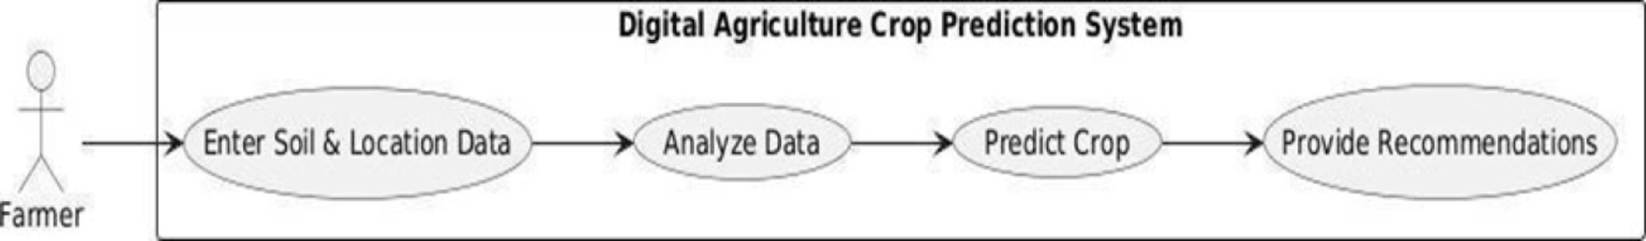
Project flow

Slide 17
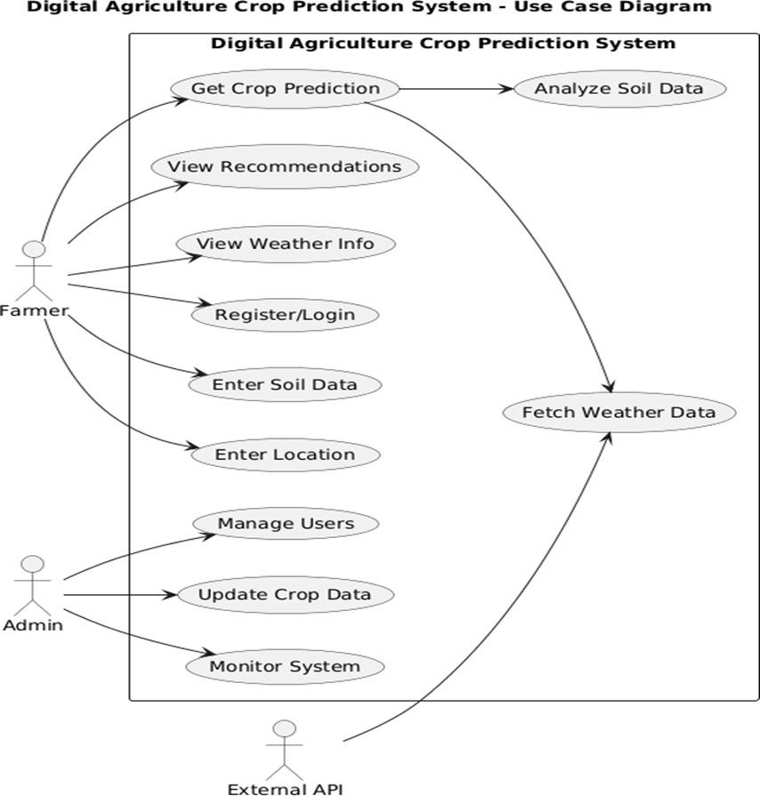
Use Case Diagram
System Actors: Defines the interactions between the Farmer (end-user), Admin (system manager), and External APIs (data providers)
Core Functionalities: Enables users to register, input soil parameters, and receive location-specific crop yield predictions
Decision Support: Provides a high-level view of how farmers view recommendations and weather info to make informed agricultural decisions.
Administrative Control: Outlines backend operations such as user management, system monitoring, and updating crop datasets.

Slide 18
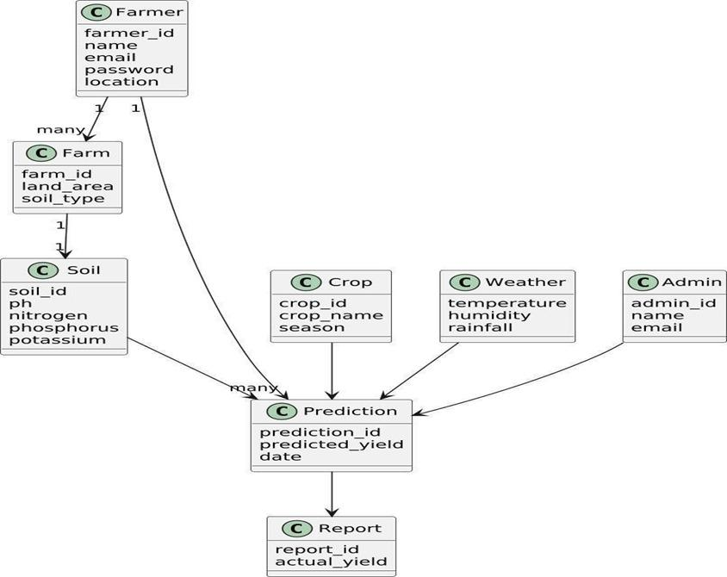
Class Diagram
Structural Representation: Defines the static structure of the system by illustrating classes, their specific attributes, and the logical relationships between them.
Central Analytic Hub: The Prediction class acts as a central link, integrating inputs from multiple entities to generate and store accurate yield results.
Core Entities: Outlines essential agricultural data models such as Farmer, Farm, and Soil, alongside environmental factors like Weather and Crop.
Data Integrity: Establishes clear associations (1-to-many) between users and their farms, ensuring a structured and scalable flow of agricultural data.

Slide 19
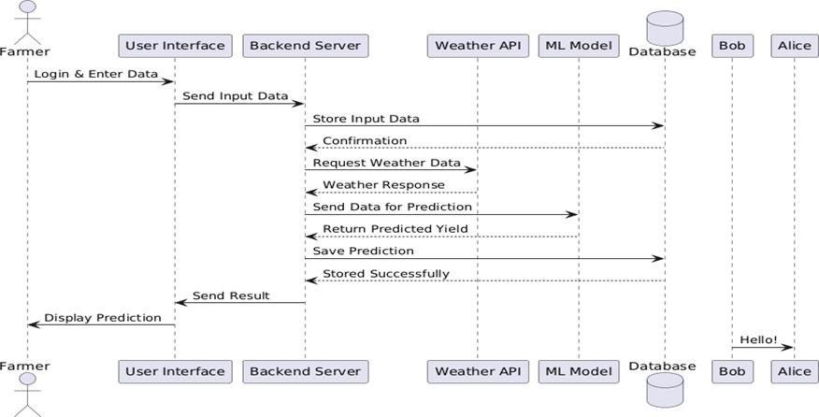
Sequence Diagram
Dynamic Interaction: Illustrates the time-ordered exchange of messages between system components during the crop prediction process.
Request Management: Shows how the Backend Server coordinates data flow between the Farmer, the Database, and external Weather APIs.
ML Integration: Details the sequence of sending combined soil and weather datasets to the ML Model for generating predicted yields.
System Completion: Highlights the final stage where prediction results are stored for historical reference and displayed back to the user interface

Slide 20
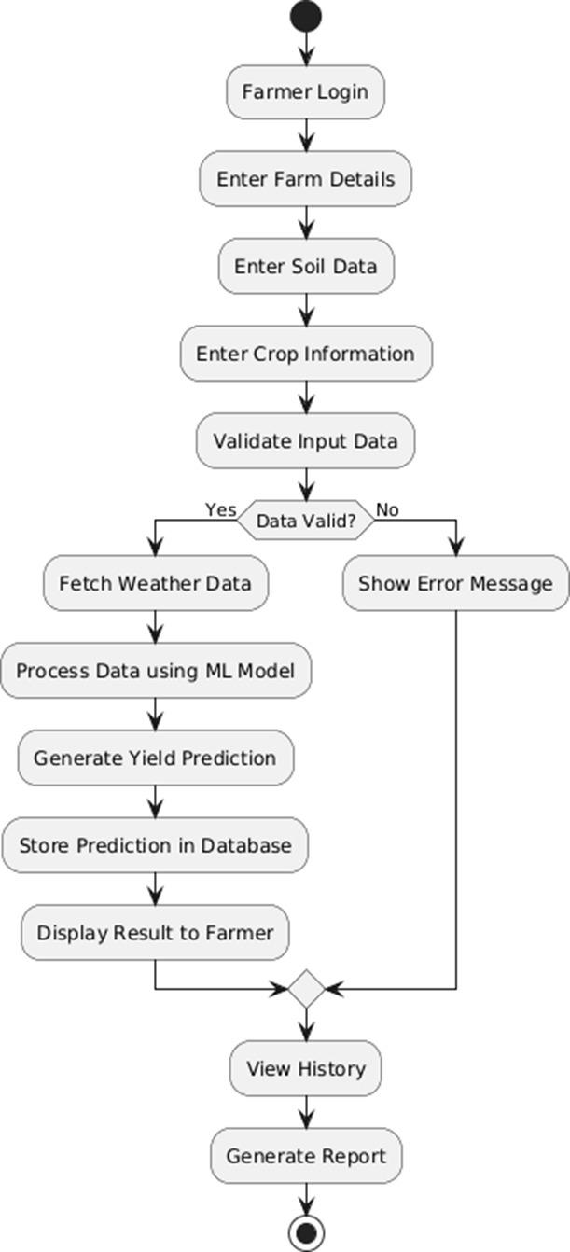
Activity Diagram
Workflow Visualization: Represents the step-by-step operational flow of the system, starting from the farmer’s initial login to the final report generation.
Logical Control Flow: Illustrates how the system transitions between different activities, such as data entry, validation, and real-time processing.
Decision Point Management: Highlights the critical validation step that determines if the system proceeds to fetch weather data or prompts the user with an error message for correction
Analytical Execution: Maps out the core processing sequence where soil and weather data are integrated using the ML model to generate and store yield predictions

Slide 21
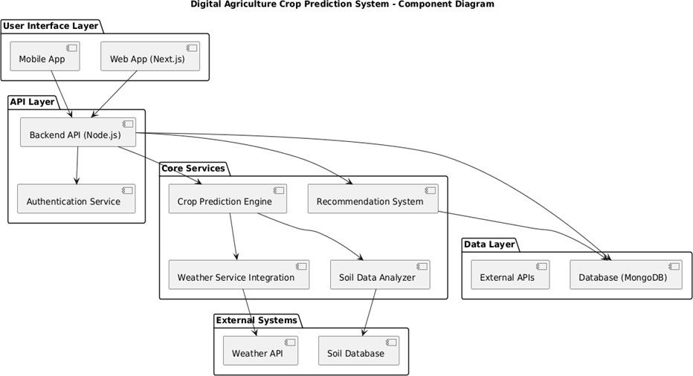
Component Diagram
Modular Architecture: Illustrates the high-level structural view of the system, divided into independent, interconnected layers for enhanced scalability and maintainability
Layered Separation: Clearly separates the system into the User Interface Layer, API Layer, Core Services, and Data Layer to reduce dependencies.
System Integration: Highlights how internal components like the Crop Prediction Engine interact with external services, including the Weather API and Soil Database
Robust Data Handling: Shows the backend coordination between the Node.js API and the MongoDB database to manage large volumes of user and environmental data

Slide 22
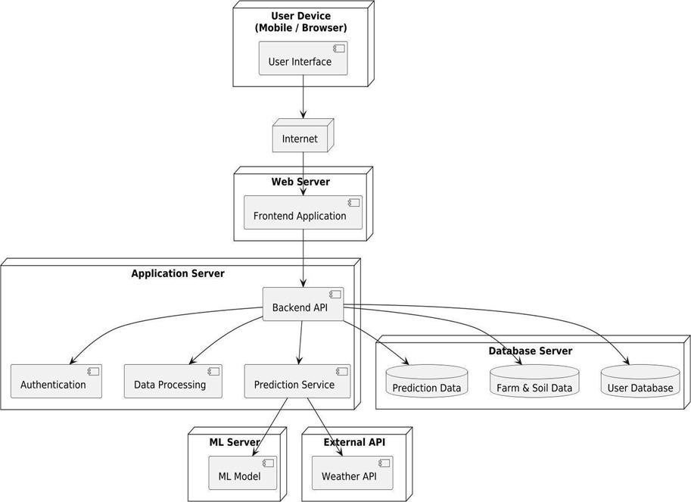
Deployment Diagram
Physical Architecture: Illustrates the hardware nodes and the runtime environment where software components are deployed for real-world operation
Node Distribution: Maps out the relationship between the User Device (Mobile/Browser), the Application Server, and the Database Server
External Connectivity: Demonstrates secure internet-based communication with external services, including the ML Server and the Weather API
Scalability and Security: Designed to handle multiple concurrent requests while centralizing sensitive data processing on the server side to protect user information

Slide 23
Database Schema
The database serves as a structured repository for all agricultural data, ensuring quick retrieval and accurate historical tracking.
Three-Tier Architecture
Key Entities
Data Flow
Separates the system into a Presentation Layer (UI), Application Layer (Backend logic), and Data Layer (Database).
Data is organized into tables for Farmers, Soil Data, Weather Data, Crops, and Predictions.
Farmers enter soil data, the backend retrieves weather data, and the prediction engine processes these inputs to return recommendations.

Slide 24
Chapter 4
Implementation

Slide 25
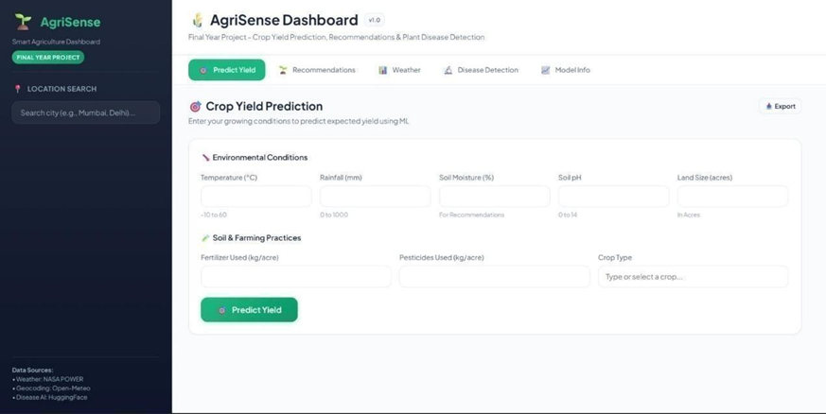
User Dashboard

Slide 26
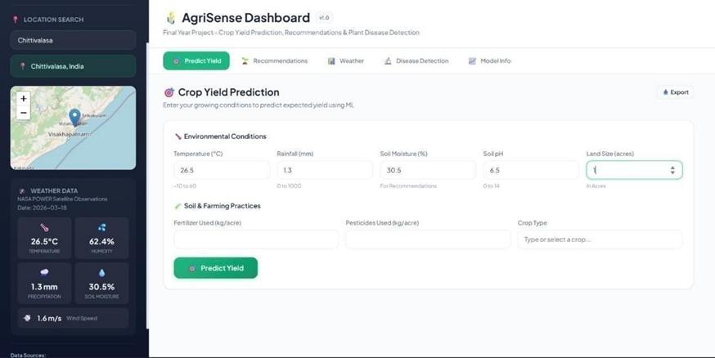
Parameter Adjustment Based on Location

Slide 27
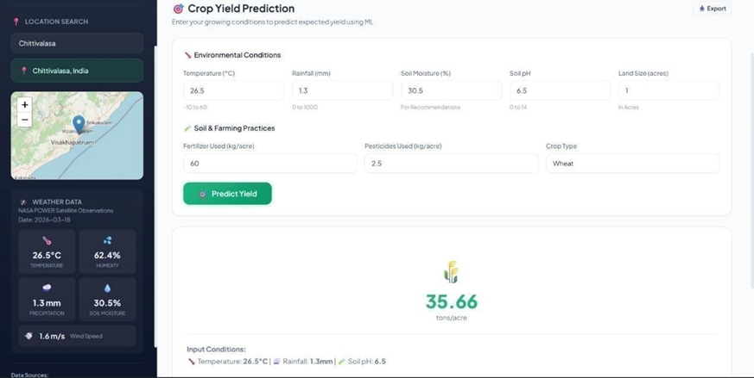
Crop Yield Prediction

Slide 28
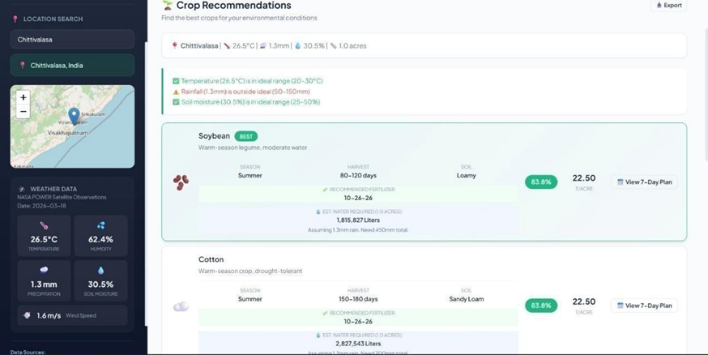
Best Crop Recommendation

Slide 29
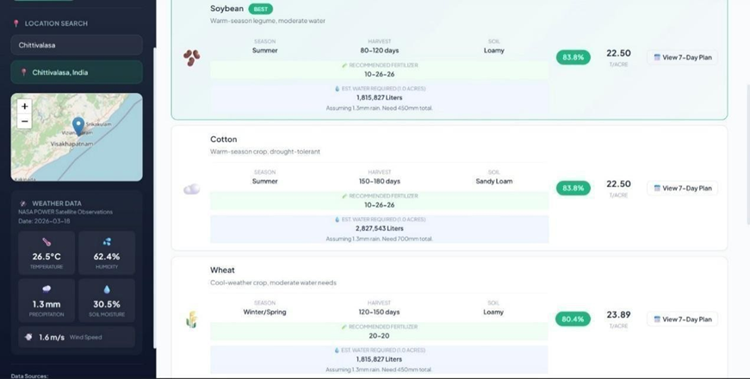
Water and Fertilizer Requirement for Recommended Crops

Slide 30
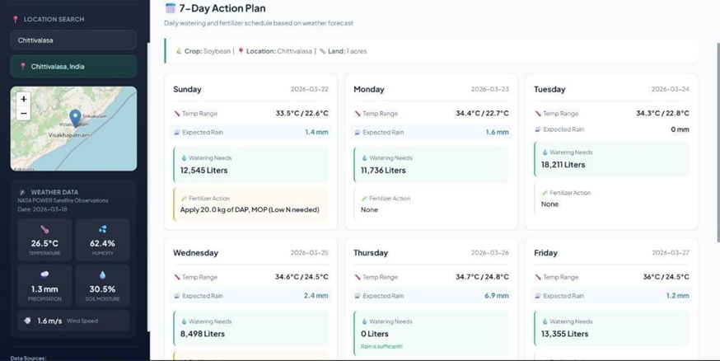
Weather-Based Water and Fertilizer Adjustment Plan

Slide 31
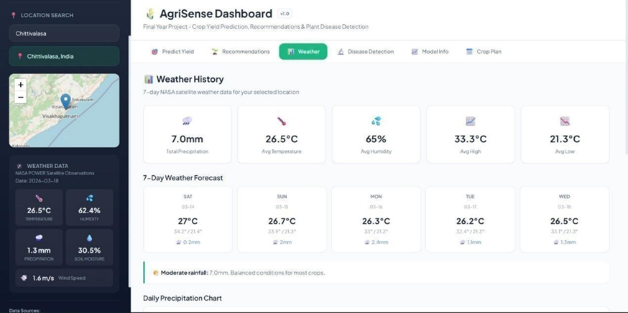
Weather Forecast

Slide 32
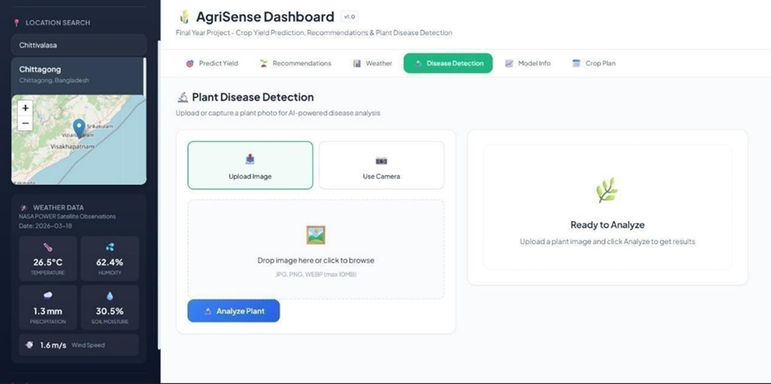
Crop Disease Detection Interface

Slide 33
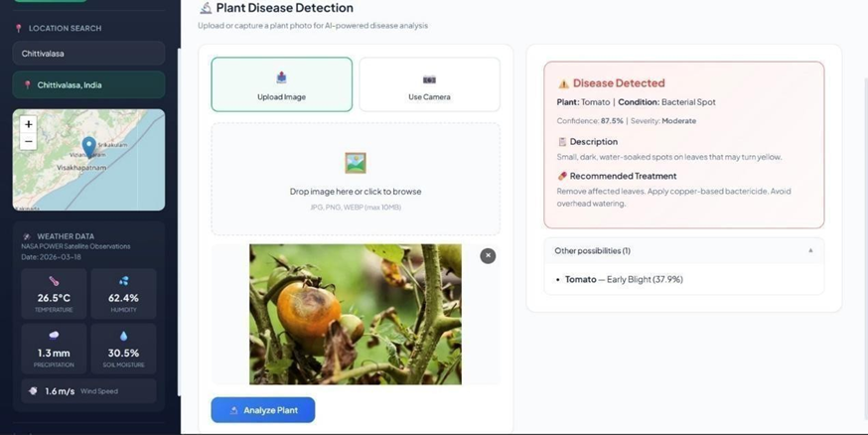
Crop Disease Prediction

Slide 34
References
APIs
NASA POWER Climate Data Services and Hugging Face AI Models.
Software
TensorFlow, Scikit-learn, Flask, and Python documentation.
Research
Food and Agriculture Organization (FAO) and Indian Council of Agricultural Research (ICAR).
Resources
QR code provided in the project document for direct access to all related code and documentation.

Slide 35



Future Enhancements
The platform is designed for continuous improvement to further enhance the user experience and reach.
Accessibility
Language Support
Advanced Technology
Integration of voice-based interaction to support users with varying literacy levels.
Expanding the interface to include multiple local languages like Telugu and Hindi.
Integration with Learning Management Systems (LMS) and IoT sensor networks for real-time field monitoring.

Slide 36
Thank You

